Slide 1
ICPD Beyond 2014 – Framework of Actions Briefing on the findings of the ICPD Beyond 2014 Review

Slide 2
1994 ICPD Consensus
Increasing social, economic and political equality, including sexual and reproductive health and rights, is the basis for individual well-being, lower population growth, and sustainable development.
The evidence of the Review overwhelmingly supports that consensus.

Slide 3
ICPD Beyond 2014
Substantial Achievements
Unequal Progress
New Challenges & Opportunities
Fragmented Implementation
Re-affirming the ICPD Programme of Action core message:
….that investing in individual human rights, capabilities and dignity – across multiple sectors and throughout the life-course – is the foundation of sustainable development.

Slide 4
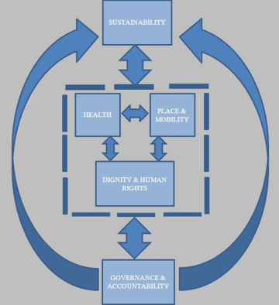
Thematic Pillars for Population & Development Post-2014

Slide 5
Cross-Cutting Issues
Human Rights
Equality

Slide 6
Cross-Cutting: Human Rights
Affirming the rights & freedoms set forth in the Universal Declaration of Human Rights, without distinction of any kind.
Throughout, the Report highlights progress in International & Regional human rights since ICPD…
Yet gaps remain in the equitable application to all persons.

Slide 7
Cross-Cutting: Equality
“The relationship of population to development is so intertwined with issues of poverty, patterns of production and consumption, and inequality, that none can be fruitfully addressed in isolation.”
ICPD Programme of Action, 1994
No less critical today.
The Review clearly underscores the unfulfilled realization of equality in income, wealth, educational attainment, health, or opportunity.

Slide 8
Methods & Sources
Global Survey of 176 governments:
Elaboration of Institutions, Laws, Policies
Commitments made over the past 5 years
Priorities for the next 5 years
Regional Conferences
Three Thematic Meetings: youth, human rights, women’s health
Meeting on Monitoring ICPD Beyond 2014
National data on outcomes (Population Division, DHS, MICS, WHO, UNAIDS, UNICEF, et al)

Slide 9
Dignity
DIGNITY &
HUMAN RIGHTS
Wealth
Education
Employment
Discrimination
Women
Adolescents and Youth
Older Persons
Persons with Disabilities
Indigenous Peoples
Non-discrimination applies to all persons

Slide 10
Global Wealth Pyramid (Credit Suisse 2012)
32 m (0.7%)
1,066 m
(22.9%)
3,207 m
(68.7%)
361 m (7.7%)
In 2012 approximately 8% of adults controlled over 80% of the world’s wealth
> USD 1 m
USD 98.7 trn (41%)
USD 100,000 to 1 m
USD 101.8 trn (42.3%)
USD 10,000 to 100,000
USD 33 trn (13.7%)
< USD 10,000
USD 7.3 trn (3%)
Total wealth
(percent of world)
Wealth
Number of adults (percent of world population)

Slide 11
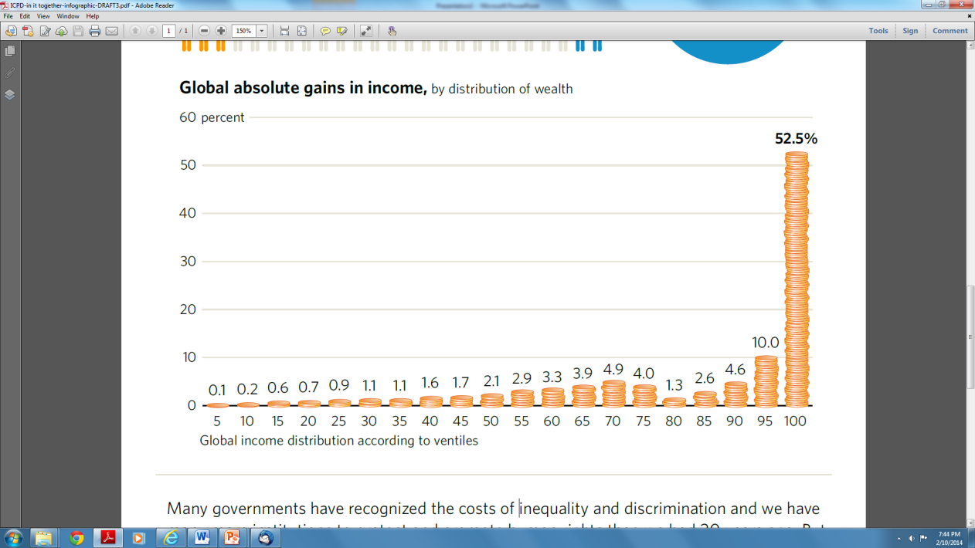
53% of all gains in global income to top 5% of earners 1988-2008

Slide 12
Cost of Inequality
Diversion of the world’s wealth – and finite natural resources – to a small fraction of the population
Limits resources for poverty reduction & sustained growth
Limits political access for some, when assets define influence
Reduces social cohesion, upward mobility, empathy, and shared responsibility

Slide 13
Women’s Empowerment & Gender Equality
Gender gap in labor force participation narrowed slightly since 1994, but women are still:
Paid less than men for equal work
Over-represented in vulnerable, informal employment
Under-represented in positions of power
Carrying a disproportionate share of unpaid domestic work
Gender-based violence demands urgent attention
1 in 3 women report physical/sexual abuse
1 in 4 men in a 10,000 person multi-country study in Asia & Pacific admitted to perpetrating rape
Government priorities for gender equality and women’s empowerment: economic empowerment and employment (71%), political empowerment and participation (59%) and the elimination of all forms of violence (56%).

Slide 14
Support for gender equality by region 2004-2009
Support for gender equality
The report presents new findings from the World Values Survey showing that public attitudes to gender equality vary greatly between countries, and region. Respondents in most counties agree that both girls and boys deserve equal access to a university education, but when asked whether girls and boys have equal rights to a job – many countries disagree.

Slide 15
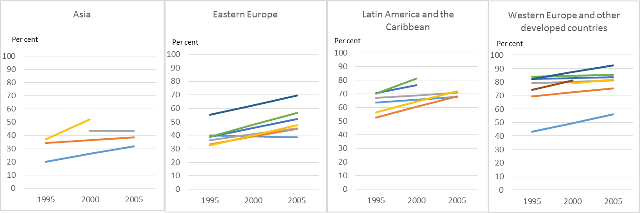
“Men make better political leaders than women” Proportion who disagree - 1995-2005
Support for gender equality
Since the 1990’s, an increasing proportion of people disagree that “men make better political leaders than women” , showing growing support for gender equality (from analysis of World Values Survey data).

Slide 16
% of Governments Addressing Equality in Work & Family Life? (Global Survey 2012)
85% Commitments or laws against workplace discrimination of women
64% Policy commitments to work/family balance
90% Maternity leave
54% Paternity leave
41% Breastfeeding in the public workplace
~ All 5 policies & provisions? 18.7% (26/113)

Slide 17
A rising proportion of older persons (60+ years), 1950-2050
11% globally, rising in all regions
> 40% of persons 65+ in Africa economically active
Illiteracy high (25% in LA, 68% in Africa) – higher among women
ANTICIPATE: Pensions, health care, innovative housing, social protection, lifelong learning, flexible employment

Slide 18
The demographic importance of young people 10-24 yrs, 1950-2050
Primary school enrollment rates approaching 90%, secondary far from universal
Of 197 million people unemployed, nearly 40% are age 15-24
600 million productive jobs needed over the next decade

Slide 19
Invest in Adolescents & Youth
34% of women 20-24 in developing regions are married or in union by age 18; 12% by age 15
Early marriage leads to early fertility: 1 in 5 girls in developing countries become pregnant before age 18
Higher levels of education delay marriage, fertility
Investments are critically needed to ensure quality health and education, freedom from early marriage & childbearing, opportunities for safe paid work, and political participation.
Government priorities for young people: economic empowerment and employment (70 %), social inclusion and education (56 %)

Slide 20
Stark Health & Wealth Inequalities for Indigenous Peoples
Life expectancy of indigenous vs. non-indigenous children:
20 years in Nepal or Australia
13 years in Guatemala
11 years in New Zealand
Among 28 million indigenous people in Latin America almost no change in poverty (~80%) from early 1990’s to early 2000’s, and poverty among indigenous…
8x non-indigenous in Paraguay
6x … Panama
3x …Mexico

Slide 21
Unequal Burden of Disability
5% age 0-14 live with a disability
15-20% over age 15 live with disability
Rising dramatically with age – and increasing due to population aging, rise in years lived with non-communicable diseases
Women more than men
Higher in lower income countries

Slide 22
Non-Discrimination Must be Universally Applied
Ethnic and Racial Minorities
Persons of Diverse Sexual Orientation and Gender Identity
Persons Living with HIV and AIDS
Migrants
Sex Workers
……….many others

Slide 23
Social Cost of Discrimination
Even without physical violence, stigma and stereotype threat leads to loss of human health and productivity:
negative birth outcomes
higher depression and anxiety
lower performance on aptitude tests and productivity
World Values Survey data highlights national differences in discriminatory attitudes:
where greater intolerance, directed towards multiple population groups

Slide 24
Key Areas for Future Action: Dignity & Human Rights
Wealth and income inequalities are increasing
Empowerment of women and gender equality remain unfulfilled
Lifelong learning, and building human capabilities, warrants substantial investment – especially for young people
Eliminate discrimination and marginalization

Slide 25
Dignity
HEALTH
Spatial &
Social Inequalities
47% decline in maternal mortality
Rising Use of Contraception
Unsafe Abortion Continues
Challenge of STIs
Gaps in young people’s SRH
Comprehensive Sexuality Education is more effective with attention to gender

Slide 26
Changes in Global Health 1990-2010
Life expectancy increased from 64.8 years in 1990-95 to 70 years by 2010-2015 (5.2 years)
Under-5 mortality rate dropped from 90 deaths per 1,000 live births in 1990 to 48 in 2012
Dramatic shifts in global health burden towards non-communicable diseases (NCDs) and injuries
But - persistence of communicable, maternal, nutritional and neonatal disorders in sub-Saharan Africa, South Asia

Slide 27
Contraceptive Prevalence Rate (CPR) increased ~ 10% world-wide, 1990-2010
Percentage of married (or in union) women 15 – 49 years who are using modern method of contraceptive, 1994 and 2014
Source: UN Department of Economic and Social Affairs, World Contraceptive Use 2012

Slide 28
Good progress: Absolute & Relative Gains in CPR
Good progress: Absolute & Relative Gains in CPR
Source: MDG5b+ Database and additional analysis, UNFPA

Slide 29
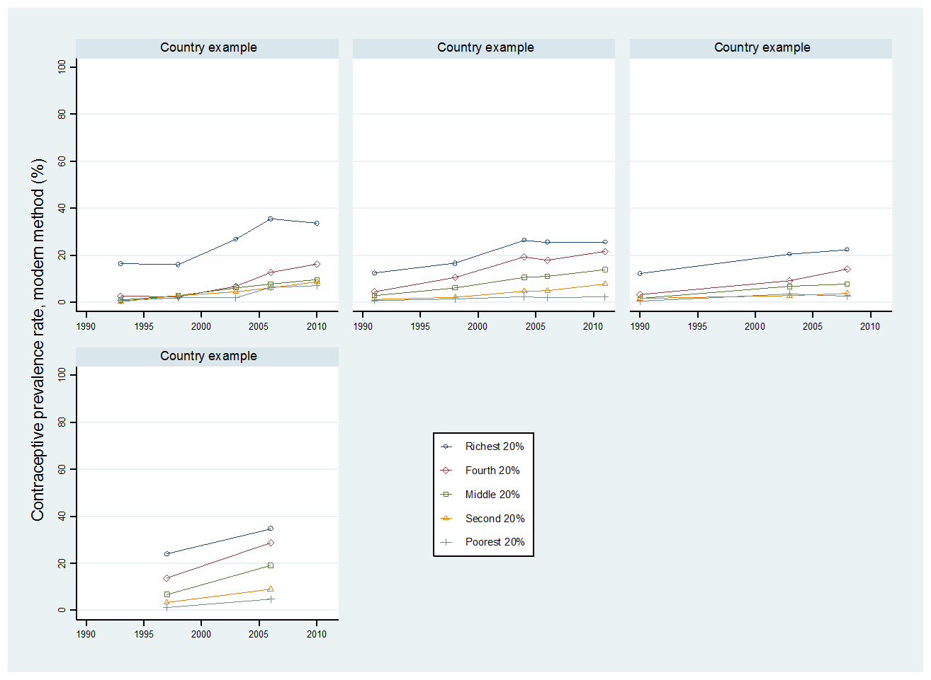
Stagnancy / increasing inequalities in CPR
Source: MDG5b+ Database and additional analysis, UNFPA

Slide 30
Skilled Birth Attendance increased ~ 19% worldwide, 1990-2010 (DHS, MICS)
Percentage of women who had a skilled attendant (doctor, nurse or mid-wife) at birth, 1990 and 2010
Source: UN Millennium Development Goals 2012 Report Statistical Annex
Notes:
MMR 47%

Slide 31
In some countries, good progress: Absolute & relative gains in use of Skilled Attendance
Source: MDG5b+ Database and additional analysis, UNFPA

Slide 32
In select countries, stagnancy or increasing inequalities in
the use of Skilled Attendance
Source: MDG5b+ Database and additional analysis, UNFPA

Slide 33
Abortion
Decline in deaths due to abortion from 50 to 30 deaths for every 100,000 unsafe abortions
Yet death rates in Africa and Asia still 460 and 160 deaths per 100,000 unsafe abortions
In countries where abortion is rare and safe:
It is legal & accessible
Modern contraception is widely available
Young people have access to comprehensive sexuality education
Gender equality is more fully realized

Slide 34
Sexually Transmitted Infections have risen - weak surveillance
WHO reports 40% rise in STI incidence (trichomoniasis, gonorrhea) over the past 20 years – (esp Latin America, SSA)
But monitoring is extremely weak outside the wealthiest countries
Better diagnosis and surveillance of STIs is sorely needed throughout the world

Slide 35
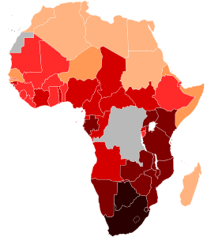
HIV is far from eradicated
33% global decline new HIV infections
But decline in preventive behavior in some countries
Delayed infection in southern Africa
Only 34% of eligible patients get ART
Access to ART continues to favor adults over children
HIV is rising in Eastern Europe, Central Asia
World Bank 2011

Slide 36
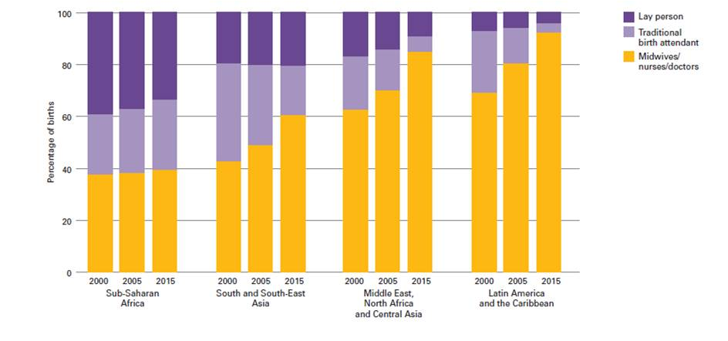
Proportion of births assisted by trained providers (midwives/nurses/doctors) is rising, but not in sub-Saharan Africa
100
80
60
40
20
0
Lay person
Traditional birth attendant
Midwives/nurses/
doctors
Percentage of births
2000 2005 2015
2000 2005 2015
2000 2005 2015
2000 2005 2015
Sub-Saharan South and South-East Middle East, Latin America
Africa Asia North Africa and the Caribbean
and Central Asia

Slide 37
Poor monitoring of young people’s access to SRH & CSE
Limited SRH service data available for youth yet…
Women < 25 yrs account for ~50% of deaths from abortion
Persons 15-24 yrs account for 41% of new HIV infections worldwide in 2009
Comprehensive Sexuality Education (CSE) evaluations suggest that addressing gender and power leads to better health outcomes

Slide 38
Key Areas for Future Action Health
Health systems need innovative strengthening to ensure universal access to quality SRH
human resources
information systems for continuity of care
rural and urban service linkages
HIV and SRH services need to be fully integrated
Improve access to SRH & CSE for young people, including age 10-14, address gender
Strengthen STI diagnostics, treatment, surveillance
Start building systems for reproductive cancers, NCD, elder care

Slide 39
Dignity
PLACE & MOBILITY
Spatial & Social Inequalities
Household structures are changing
Urbanization is growing
International migration has diversified
Many suffer from insecurity of place

Slide 40
Changes in living arrangements, households
Single-person households are rising in all regions outside of Africa
Persons never married has risen across a majority of countries of Europe, Oceania and the Americas
Proportion of persons divorced or separated has increased
Single parent households are rising – not in all regions – and these households are primarily headed by women

Slide 41
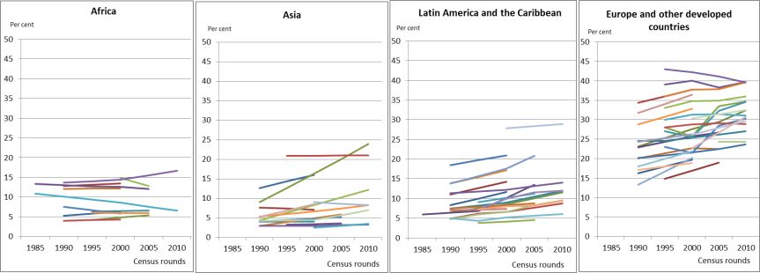
Rising proportion of one-person households in select countries 1990-2010 (IPUMS)

Slide 42
Urbanization
In 2008, for the first time, more than half the world’s population became urban
90% of urban population growth in the past 20 years occurred in developing countries
Cities & towns gaining an estimated 1.3 million persons per week – due to migration & fertility
Young adults account for a large proportion of urban migrants

Slide 43
Total Population by City Size, 1970, 1990, 2011, 2025

Slide 44
Potential Benefits of Urbanization
Cities and towns are responsible for over 80% of GNP worldwide
Can reduce energy demand – by concentrating transport, housing, IT
Provides economies of scale for health, welfare and education systems
Offers autonomy, mobility, participation
But potential not assured – urban inequalities heighten vulnerability, risk and exclusion

Slide 45
Greater Diversity in International Migration
International migrants (232 million) have increased, but not as a proportion of the world population (3.2%)
More countries involved – as points of origin, destination, transit
As much migration is occurring between developing countries (82.3 million) as from developing to developed countries (81.9 million)
Approximately half of all international migrants are now women (48%) – more travelling alone, as heads of households

Slide 46
Millions without Security of Place
28.8 million displaced due to conflict, violence or human rights violations in 2013, surpassing the prior peak in 1994
32.4 million displaced due to natural disasters
865 million living in slums
No reliable count of those suffering forced evictions - 2.5 to 15 million per year?
An uncounted number of people are homeless, inadequately housed, or at imminent risk of becoming homeless

Slide 47
Key Areas for Future Action: Place & Mobility
Policies should take into account that household structures and living arrangements are increasingly diverse
The world must plan and build sustainable cities, and strengthen rural-urban linkages
International migrants need greater security, and governments should increase cooperation
Those with insecurity of place (Homelessness, Displacement) are poorly counted

Slide 48
Dignity
GOVERNANCE & ACCOUNTABILITY
Accountability
Elaboration of Institutions
Mechanisms for Oversight, Human Rights Protection & Redress
Participation
Knowledge Systems
Partnerships & Resources

Slide 49
Government commitments to participation varied for different population groups
Global Survey: % of Governments that report they are committed to the participation of key groups:
76% Adolescents and youth
73% Women
61% Persons with disabilities
47% Older persons
~ All 4 key population groups? 21.7% (30/138)

Slide 50
Knowledge Sectors are Weak in Many Countries
Monitoring population dynamics is essential to enhancing human rights, health and development, yet collection and use of data are weak
Only 109 of 193 member states have complete coverage of birth registration
Only about 1/3 of births in LDCs are registered
Very weak data on migration, either internal or international – and on those with insecurity of place – e.g. IDPs, homeless
Inadequate number of trained census experts and demographers in developing countries

Slide 51
Partnerships & Resources
Since 1994: number, diversity of donors increased
The architecture for development cooperation shaped by the urgent response to HIV/AIDS
Funding for 4 costed ICPD components (FP; RH, STI&HIV/AIDS; research, data, policy), increased in absolute dollars – dominant share to HIV/AIDS
HIV/AIDS received 66% of total assistance (2011)
RH received 22%
Global targets and accountability matter: the focus on HIV& AIDS, and the MDGs, have had impact

Slide 52
Key Areas for Future Action: Governance & Accountability
Population dynamics are critical to development planning
Knowledge sectors need strengthening
More systematic, inclusive participation
Better accountability systems for national and global programs

Slide 53
Dignity
SUSTAINABILITY
From ICPD Beyond 2014 to Post-2015
Diverse population dynamics
Threats of climate change
Cost of inequality
Paths Forward

Slide 54
Population, Consumption & Climate Change
Overall long-term population growth matters to climate change
But the error habitually made is to equate each new birth with rising emissions

Slide 55
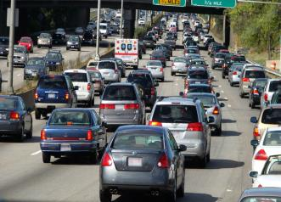
Population, Consumption & Climate Change
1 unit of emission
1 person

Slide 56
Population, Consumption & Climate Change
Greater attention needed:
Innovation, technology for green economies
Incentives to shift patterns of consumption
Infrastructure investments at scale - for public transport, housing, utilities, energy - can potentially:
Reduce emissions per capita
Increase access and participation, thereby reducing social & spatial inequalities

Slide 57
Dignity
Paths to SUSTAINABILITY
Dignity, Human Rights, Non-Discrimination for All
Lifelong investment in health & education, particularly for young people
Universal access to SRHR
Security of Place, Safe Mobility
Sustainable, inclusive cities linked to rural areas
A fundamental change in patterns of consumption
Stronger global leadership and accountability

